Slide 1
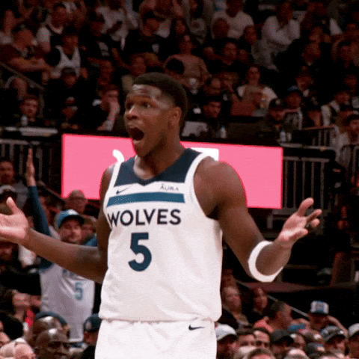
Shooters Shoot Machine Learning
Natalie, Quentin, Haley, & Lisa

Slide 2

Goal of the Project
The goal of this project is to explore and model NBA shooting performance. By combining shot-level data, player stats, and defensive context, we developed models to predict both individual shot success and game-level scoring performance. Using Random Forest and Deep Neural Networks, we aim to better understand how shot location, player tendencies, and defensive matchups influence field goal outcomes and overall player impact.
Notes:
Hi everyone, its Lisa and my group is Haley, Natalie, and Quentin. For our Capstone project, Natalie had the idea of doing an NBA Shot Prediction and Matchup Simulator. We’re combining real NBA shot data with defensive analytics to simulate how specific player matchups would play out on the court.
With the NBA Finals right around the corner, we thought it’d be fun and timely to dive into some real teams — so we picked the Minnesota Timberwolves and the New York Knicks as our focus. We used player-level shot data from the entire 2024–2025 regular season to make our predictions more complete and realistic.
The goal of this project is to explore and model NBA shooting performance. By combining shot-level data, player stats, and defensive context, we developed models to predict both individual shot success and game-level scoring performance. Using both Random Forest and Deep Neural Networks, we aim to better understand how shot location, player tendencies, and defensive matchups influence field goal outcomes and overall player impact.

Slide 3
Key Questions
Who are we building this model for/ who would use it?
Coaches & Analysts: Evaluate shooting efficiency by shot type and zone.
Fantasy Sports Players: Predict which players are likely to score efficiently.
Sports Bettors: Gain an edge by modeling performance trends.
Data Journalists: Provide insight using player and team-level shot data
What is the predicted shooting percentage FG% for each player up against the defensive of the opposing team?
What is the average FG% based on location of the shot for the team?
What are the odds a player makes a shot against certain defensive players?

Slide 4
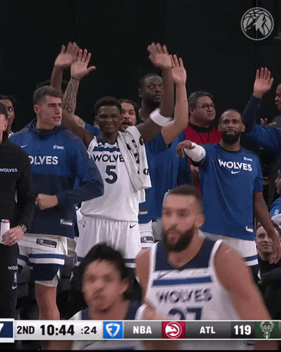
Why these predictions matter?
Improve matchup prep and game strategy
Support player development and scouting
Provide analytical support for betting and fantasy decisions

Slide 5
Data Sources and Feature Engineering
Data Sources:
Shot-Level Data: NBA player shot logs (coordinates, shot type, outcome)
Player Stats: Points, FG%, 3PT%, shot attempts, minutes played, steal %, defensive rebound %, block %, defensive win share, defensive box score +/- (season and playoffs)
Team Metrics: Opponent FG allowed, pace, defensive ratings
https://www.nba.com/stats
https://www.espn.com/nba/stats
https://github.com/toddwschneider/ballr
https://toddwschneider.com/posts/ballr-interactive-nba-shot-charts-with-r-and-shiny/
https://www.basketball-reference.com/playoffs/NBA_2025.html
Feature Engineering:
For player modeling
Aggregated Game Stats:
Total points scored
FG% shots made/attempted
Average shot distance
2-point/3-point attempts
For shot level modeling
Shot Features
Shot angle from basket
Shot distance
Zone classification ("Corner 3", "Midrange" etc.)
Notes:
*TALKING ABOUT FEATURE ENGINEERING + MODELING
To give our models context, we added features like clutch shot indicators, whether the shot was corner three, midrange, or near the basket, and created matchup specific columns like opponent block percentage and defensive win shares. These allowed us to train both classic ensemble models and deep learning model to simulate field goal percentage based on real shot history.

Slide 6
Modeling Approach
Deep Neural Network (DNN)
Built with TensorFlow/Keras
Key Features used
Shot angle from basket
Shot distance bins (one-hot encoded)
Corner 3 and midrange flags
Shot zone classifications
Defensive Player
Random Forest Classifier
Scored > 15 Points
FG% > 50%
Key Features Used:
Average Shot Distance
Number of 3-Point Attempts
Total Shot Attempts
The DNN was used to classify the likelihood of a made shot based on location and shot type, and defender, while the Random Forest model focused on predicting player-level performance outcomes like FG% and total points.
Notes:
HA
When we started this project, our original idea was to keep it simple and use a linear regression model. But we quickly realized that wasn’t going to cut it. The accuracy was extremely low — we’re talking completely unusable. And that made sense: we were trying to use a model designed for continuous prediction to solve a fundamentally binary problem — whether a shot goes in or not.
So Why a random Forest? So we pivoted to a classification approach, and after trying a few options, we landed on a Random Forest Classifier. We liked this model for a few reasons: It’s a model that doesn’t make assumptions about how the data is shaped, which was perfect for us… which means it doesn't assume a linear relationship between variables, and it's great at handling complex interactions — which our shot data definitely had. Things like game context, shot location, defender quality — these aren’t linear relationships, so Random Forest gave us that flexibility.
We actually trained the model on two separate classification targets using a multi-output classifier. The first target was whether a player would score more than 15 points in a game. The second was whether their field goal percentage for that game would be above 50%. These are both indicators of high performance — so instead of just predicting make or miss per shot, we looked at overall impact in the context of a game

Slide 7
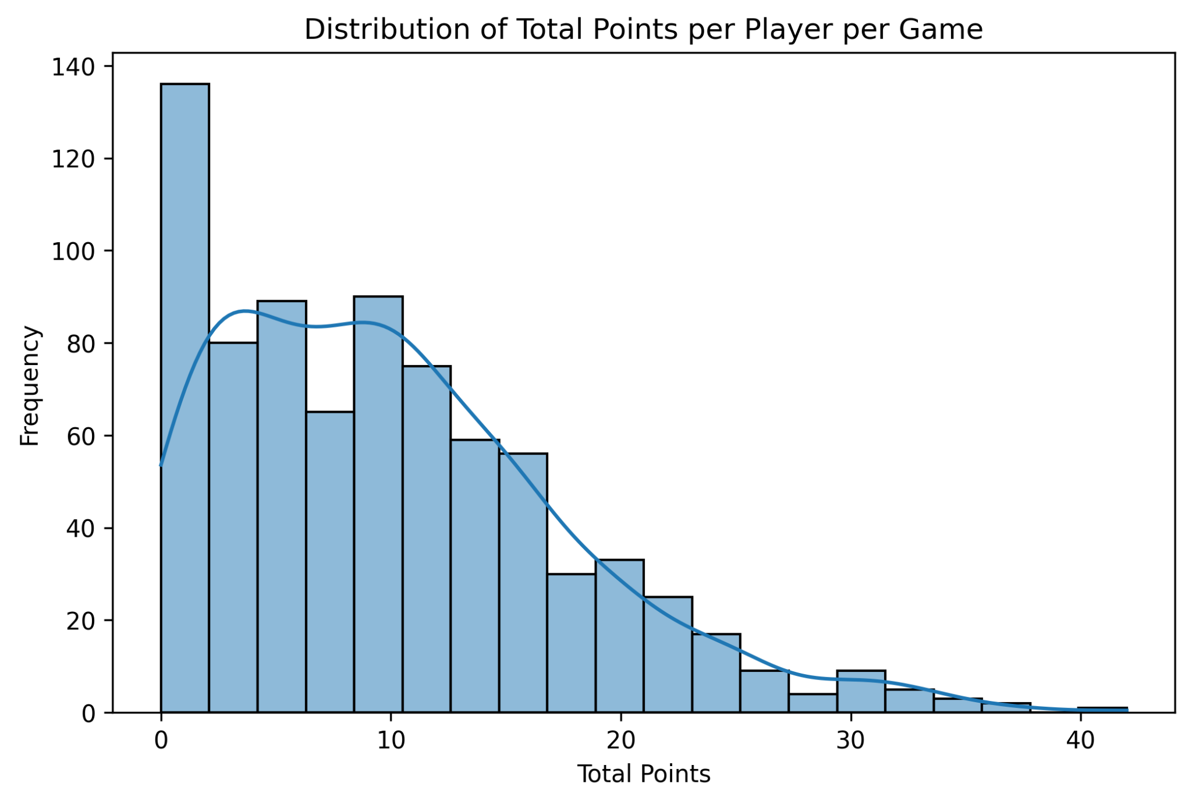
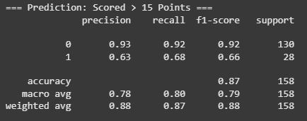
Player Performance Modeling
Players who score more than 15 points typically play a significant offensive role and can shift the outcome of a game. Modeling this outcome allows us to identify which player profiles and shooting behaviors are associated with high-volume scoring. The line helps visualize where these scoring performances are most concentrated.
Notes:
HA
X-axis Total Points: Represents the number of points a player scored in a single game, Y-axis Frequency: Shows how many times a player scored that number of points in the dataset
Some of the most important features we used in the model were average shot distance, the number of 3-pointers taken, whether the game was at home or away, and the number of clutch shots taken — which we defined as shots taken in the final 2 minutes of any period. These features were easy to engineer, but powerful in capturing player behavior.
Once trained, our Random Forest model achieved about 87% accuracy in predicting shot success — and while that may sound low at first, in the context of real-world basketball data, it’s actually solid. Shot success is inherently unpredictable — there’s luck, defense, fatigue, and emotion involved — so hitting that level with relatively few features was a promising sign
What this taught us was that traditional linear modeling just doesn’t hold up well with data that has this level of complexity and noise. Random Forest gave us a more flexible way to understand feature importance and prediction probability, and helped us set the stage for our neural network matchup simulator.

Slide 8
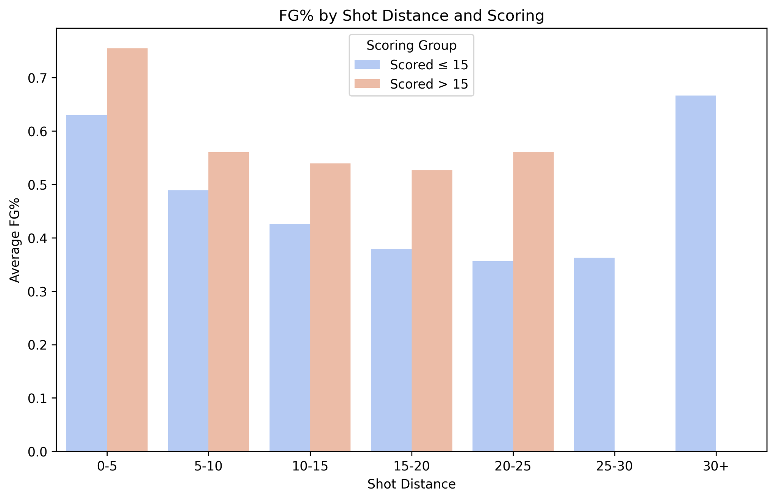
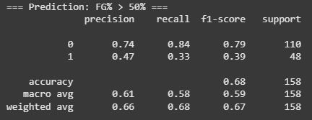
Player Performance Modeling (cont.)
Explores how shooting efficiency (FG%) varies by shot distance and scoring performance
Players who scored more than 15 typically had:
Slightly higher FG% in most distance bins.
More efficient shooting closer to the basket.
Understanding FG% by distance helps identify which types of players are high-efficiency scorers and where they are most effective on the court.
Notes:
We did this at 50% where the league average is at 47%

Slide 9
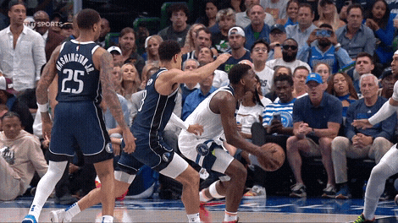
1v1 Matchups using Deep Neural Network
Simulates a realistic offensive vs. defensive matchup by combining player shot data and opponent defensive metrics to predict expected field goal percentage (FG%), and shot making probability
It integrates a wide range of engineered features, including timing variables like total seconds remaining and clutch time (under 2 minutes), shot distance and angle from the basket, and shot classifications like midrange or corner threes
Defensive context is added through opponent stats like block %, steal %, defensive win shares and shot location zones are encoded to reflect court positioning
They provide a dynamic way to evaluate shot difficulty, scoring potential, and how defenders impact a player’s efficiency.

Slide 10
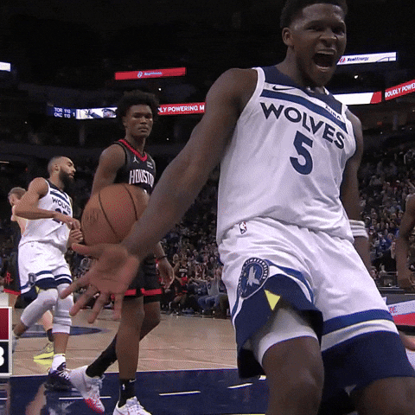
THE END

